Slide 1
Modern Application Developement I ( MAD I )

Slide 2
Final Project ( Flash Card Web App )
By ANSH KUSHWAHA
Roll No.: 21f1006019
21f1006019@student.onlinedegree.iitm.ac.in

Slide 3
INTRODUCTION
ANSH KUSHWAHA
Roll No.: 21f1006019
21f1006019@student.onlinedegree.iitm.ac.in
From Varanasi, UP
Currently pursuing BE CSE from Panjab University, Punjab

Slide 4
DESCRIPTION
To design a login authenticated web application having quiz like environment which calculates & stores the scores of each user after each game (set of 10 multiple choice questions having 4 options each) & also have three difficulty level (easy, medium, hard) options for users to choose from.

Slide 5
FEATURES
It has two login options (Administrator & User)
Administrator Login Password is set to “P@ssw0rd”
New users can login directly & the password entered will be used for further logins
Old users have to use their previous password for authentication
Administrator can view all users with their score & all decks

Slide 6
FEATURES
User can only play the game
The game has three difficulty level options (easy, medium, hard)
Each game has a set of 10 multiple choice questions having 4 options each
One question will be displayed at a time
Scores will reflect at the end of game

Slide 7
HIGHLIGHTS
Python Libraries Used:
flask
flask_sqlalchemy
flask_restful
werkzeug.exceptions
json
os

Slide 8
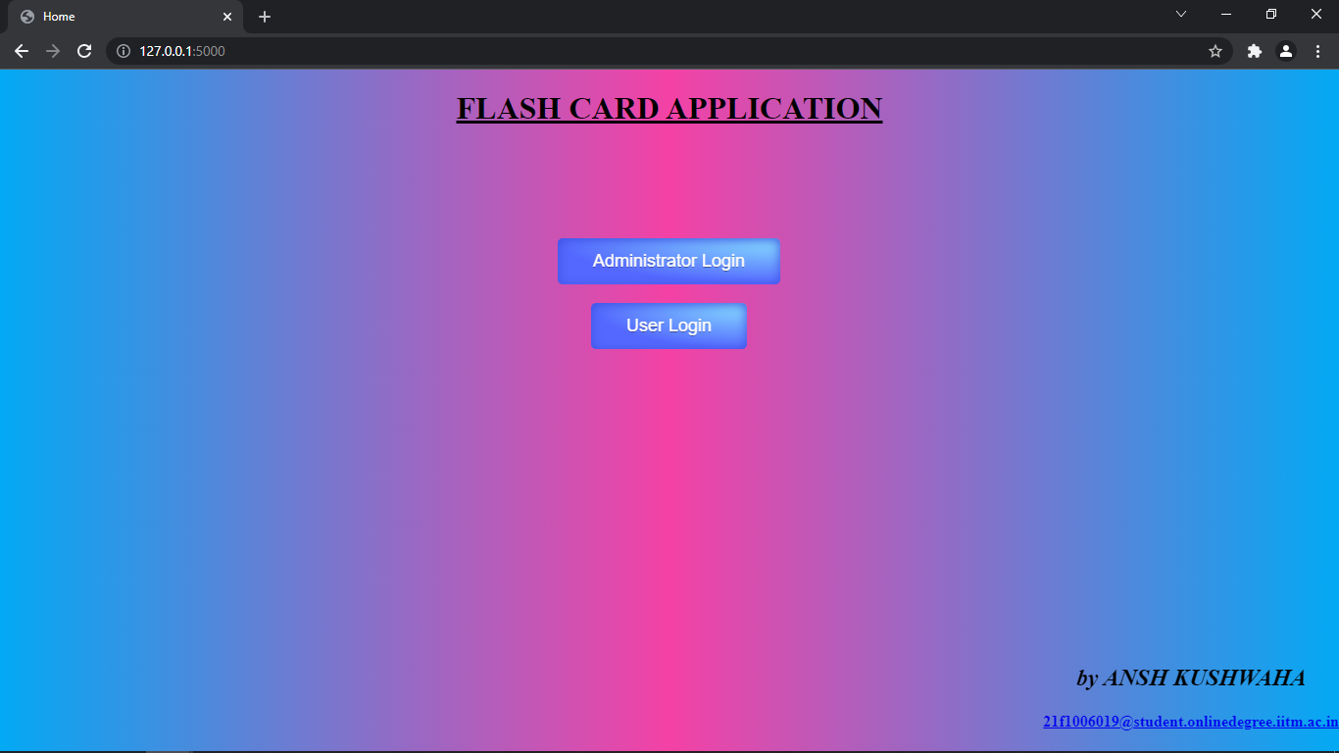

Slide 9
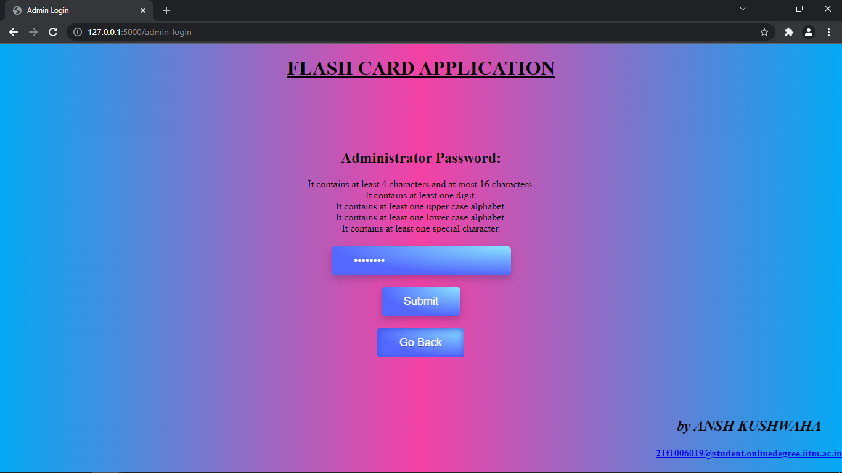

Slide 10


Slide 11
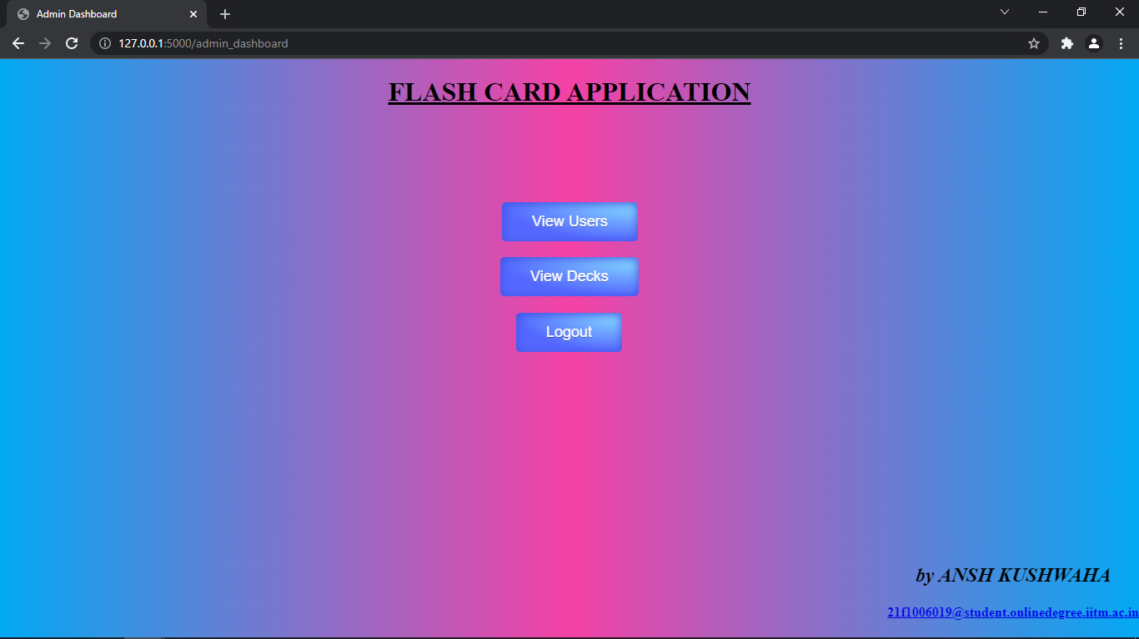

Slide 12
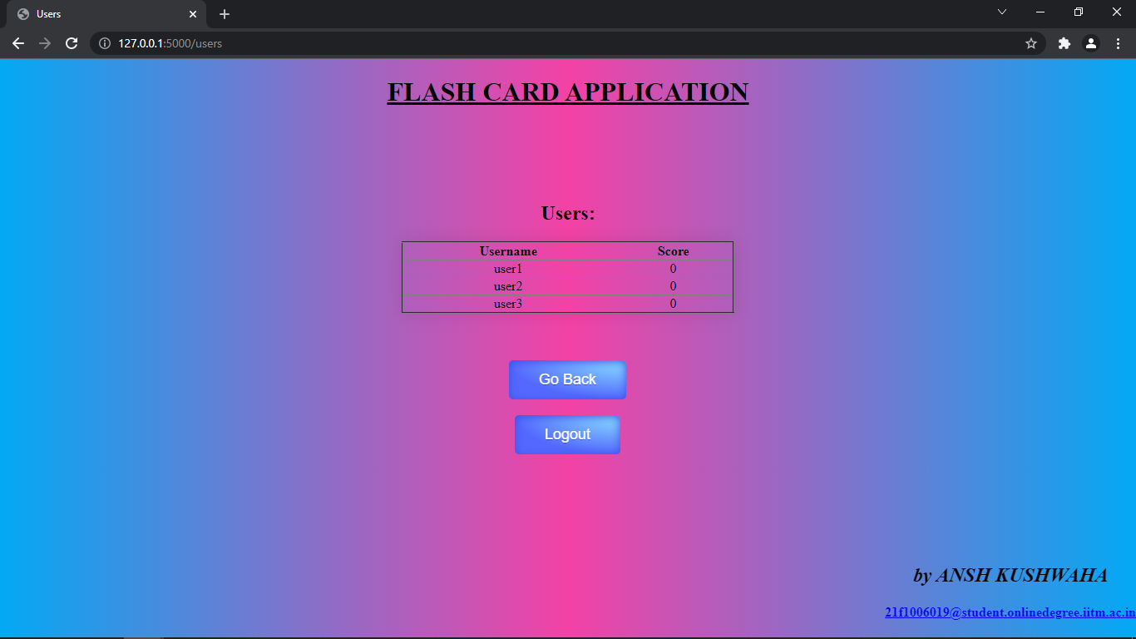

Slide 13
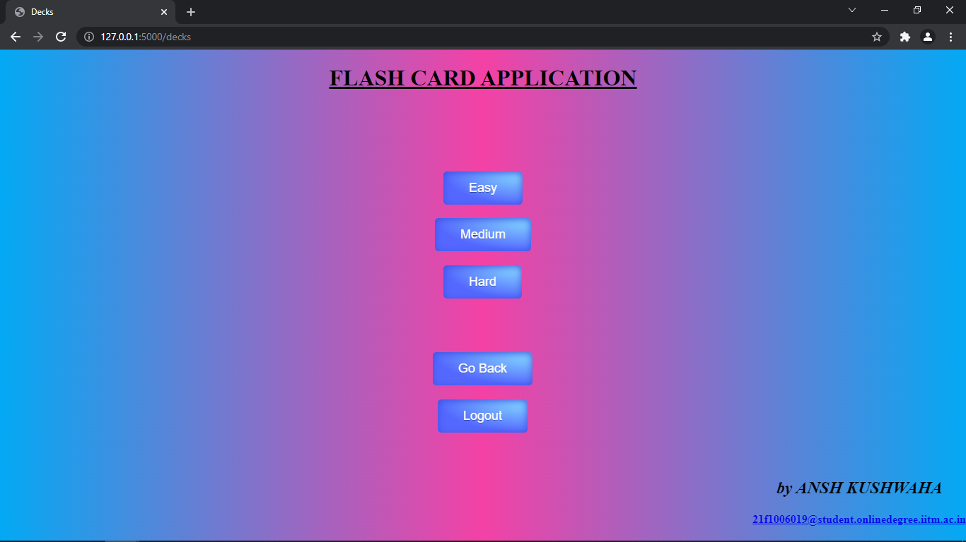

Slide 14
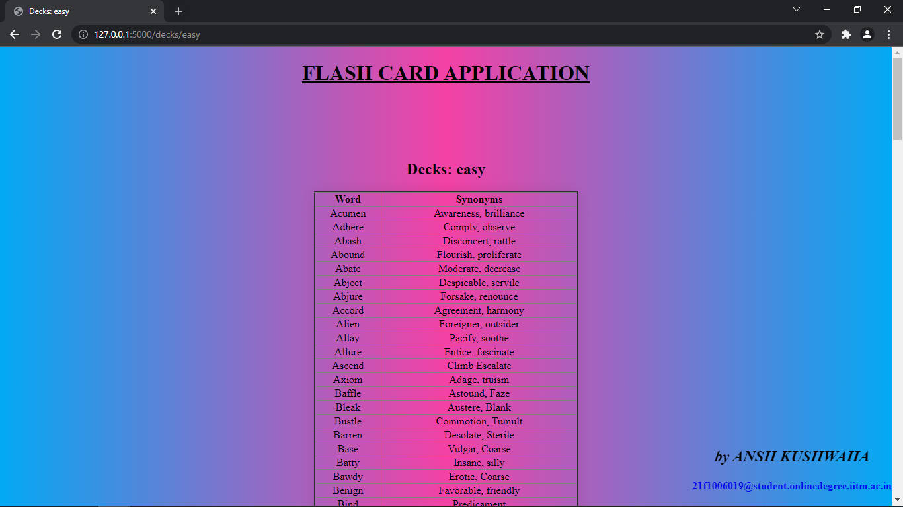

Slide 15
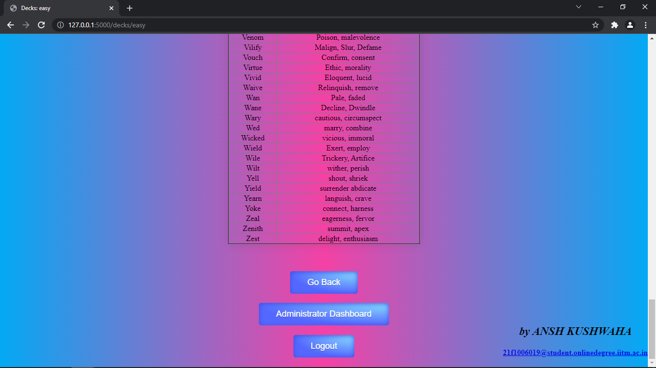

Slide 16
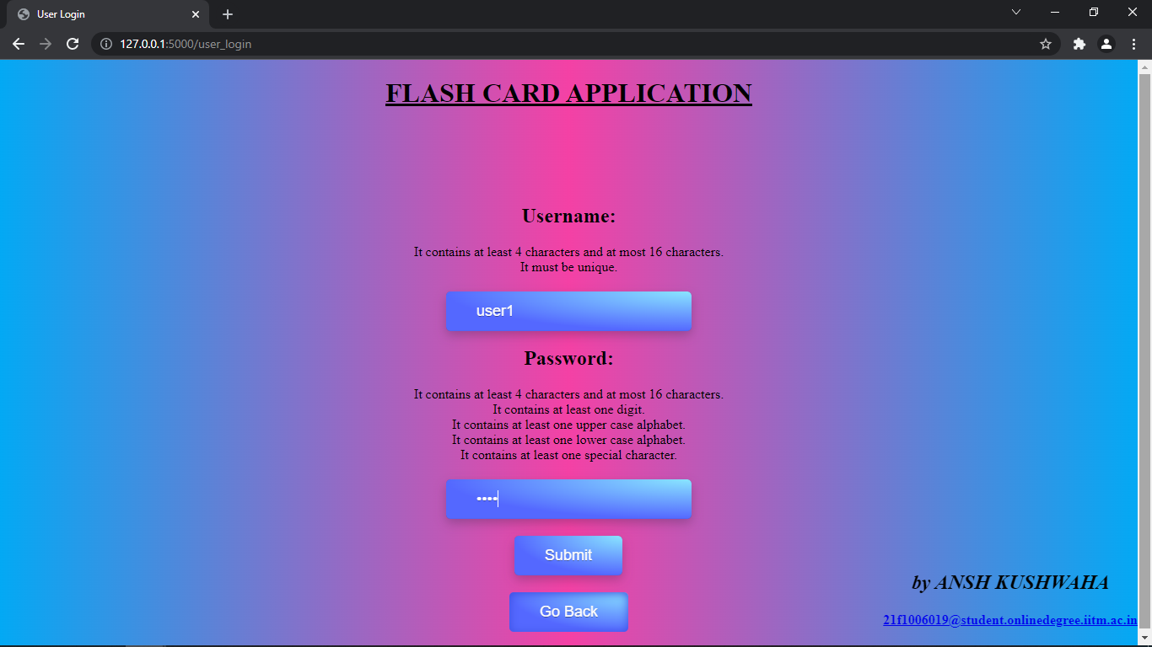

Slide 17
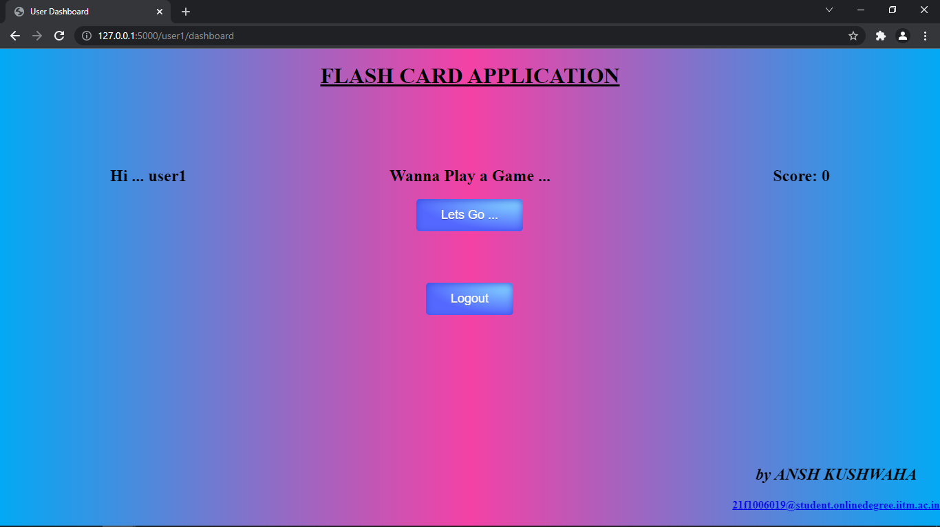

Slide 18
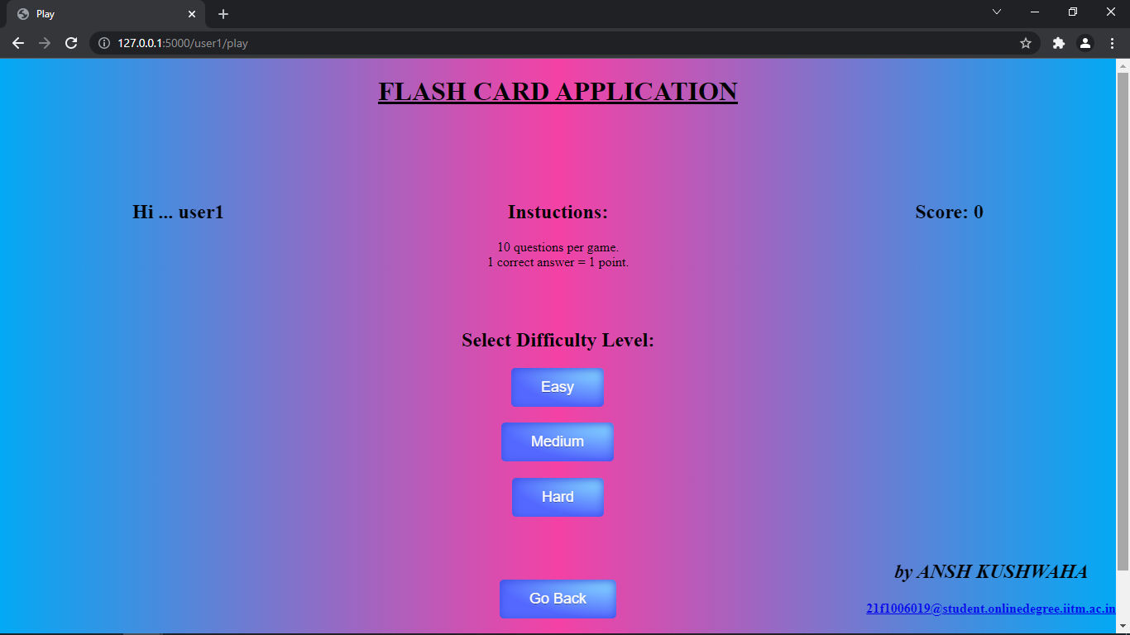

Slide 19
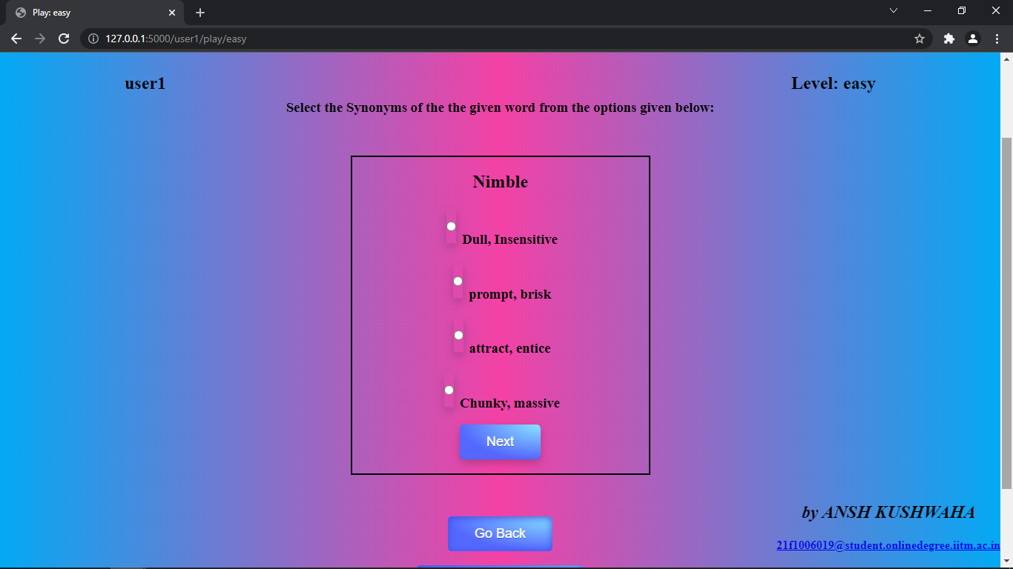

Slide 20
THANK YOU

